Slide 1
Semi-supervised classification with graph convolution networks
Presented by: Team Symphony
Ravinder Singh(20163052)
Rajat Agarwal(20163060)
Muskan Singla(20172003)
Pooja Gaur(20173037)

Slide 2
Contents
Goal
Key Concepts
Defining the Model
Semi-Supervised Node Classification
Experimental Set-up
Results discussion
Weisfeiler-Lehman Algorithm
Conclusion

Slide 3
Goal
Semi-supervised Learning based on CNN on graph structured data
A better method over- Smoothing of labels using explicit graph-based regularization
Encoding graph structure using a NN model-
motivated from 1st order approximation
of spectral graph convolutions
Notes:
We consider the problem of classifying nodes (such as documents) in a graph (such as a citation network), where labels are only available for a small subset of nodes. This problem can be framed as graph-based semi-supervised learning, where label information is smoothed over the graph via some form of explicit graph-based regularization (Zhu et al., 2003; Zhou et al., 2004; Belkin et al., 2006; Weston et al., 2012), e.g. by using a graph Laplacian regularization term in the loss function:
L = L0 + λLreg , with Lreg =X i,j Aijkf(Xi)−f(Xj)k2 = f(X)>∆f(X). (1)

Slide 4

Convolutions on a graph
Convolution
Time series
Regular connectivity
2D images, occasionally 3D tensors are special cases of the graph learning problem
Graph Convolution
Spectral view on convolutions
Different local connectivity patterns/degrees
Pointwise multiplication of the Fourier-transform

Slide 5
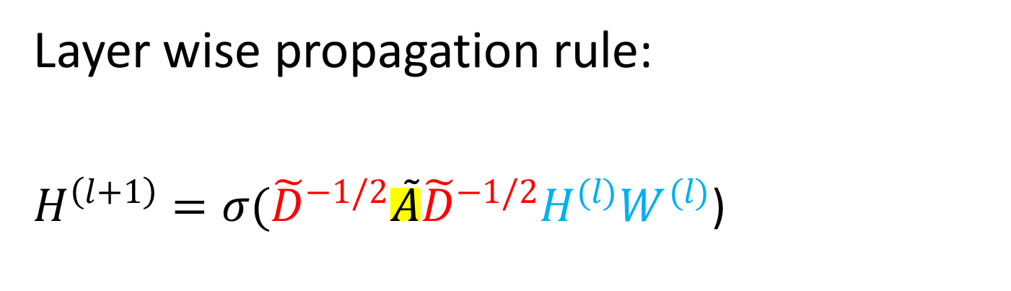
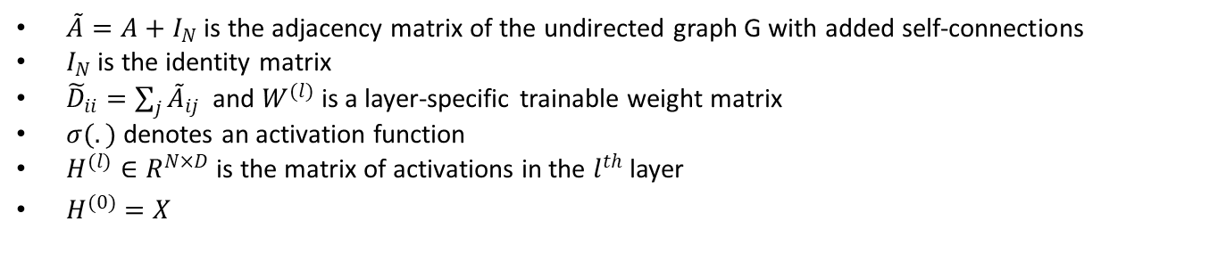
Defining the model
Layer wise propagation rule:
$H^{\left(l+1\right)}=σ({\tilde{D}}^{−1/2}\tilde{A}{\tilde{D}}^{−1/2}H^{(l)}W^{(l)}$)
$\tilde{A}=A+I_{N}$ is the adjacency matrix of the undirected graph G with added self-connections
$I_{N}$ is the identity matrix
${\tilde{D}}_{ii}=\sum_{j}{{\tilde{A}}_{ij}}$ and $W^{(l)}$ is a layer-specific trainable weight matrix
$σ(.)$ denotes an activation function
$H^{(l)}∈R^{N×D}$ is the matrix of activations in the $l^{th}$ layer
$H^{(0)}=X$
Notes:
In this work, we encode the graph structure directly using a neural network model f(X,A) and train on a supervised target L0 for all nodes with labels, thereby avoiding explicit graph-based regularization in the loss function. Conditioning f(·) on the adjacency matrix of the graph will allow the model to distribute gradient information from the supervised lossL0 and will enable it to learn representations of nodes both with and without labels

Slide 6
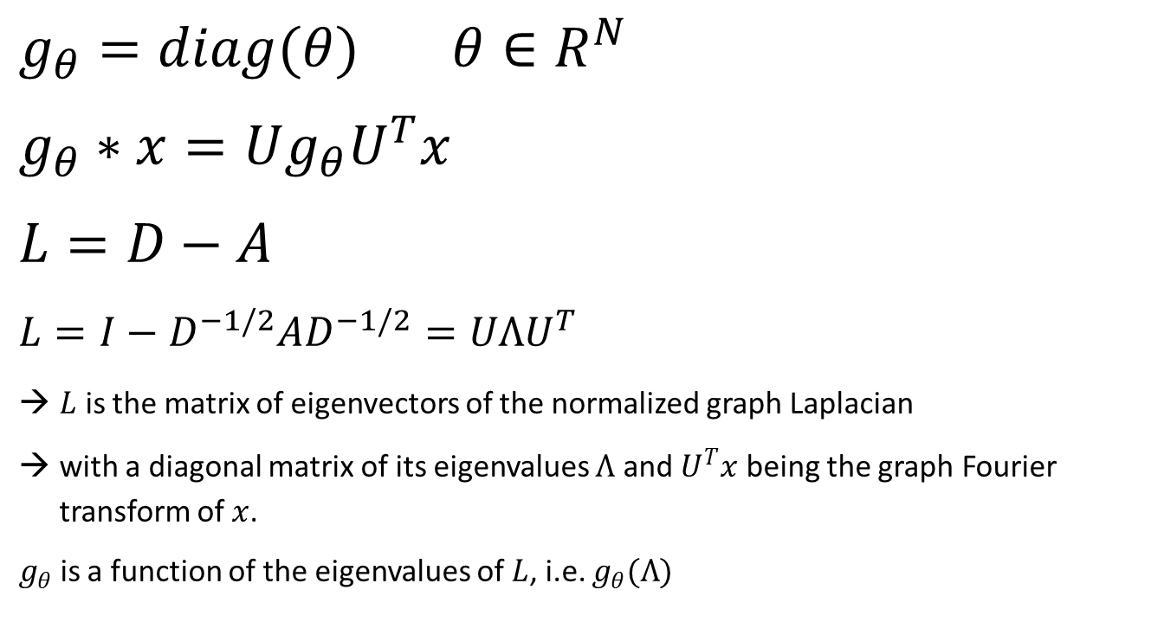
Defining the model- derive Spectral 1storder approx
Spectral graph convolution:
Fourier domain & Laplacian graph
$g_{θ}=diag(θ)$ $θ∈R^{N}$
$$g_{θ}∗x=Ug_{θ}U^{T}x$$
$$L=D−A$$
$$L=I−D^{−1/2}AD^{−1/2}=UΛU^{T}$$
$L$ is the matrix of eigenvectors of the normalized graph Laplacian
with a diagonal matrix of its eigenvalues $Λ$ and $U^{T}x$ being the graph Fourier transform of $x$.
$g_{θ}$ is a function of the eigenvalues of $L$, i.e. $g_{θ}(Λ)$
Notes:
In this work, we encode the graph structure directly using a neural network model f(X,A) and train on a supervised target L0 for all nodes with labels, thereby avoiding explicit graph-based regularization in the loss function. Conditioning f(·) on the adjacency matrix of the graph will allow the model to distribute gradient information from the supervised lossL0 and will enable it to learn representations of nodes both with and without labels

Slide 7
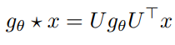
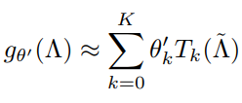
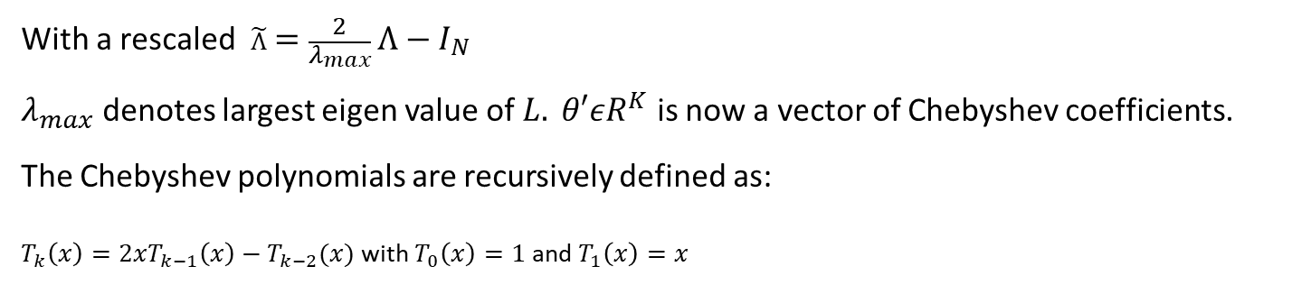
Defining the model- derive Spectral 1storder approx
Expressed using Chebyshev polynomials of eigenvalues in spectral domain
With a rescaled $\tilde{Λ}=\frac{2}{λ_{max}}Λ−I_{N}$
$λ_{max}$ denotes largest eigen value of $L. θ′εR^{K}$ is now a vector of Chebyshev coefficients.
The Chebyshev polynomials are recursively defined as:
$T_{k}\left(x\right)=2xT_{k−1}\left(x\right)−T_{k−2}(x)$ with $T_{0}\left(x\right)=1$ and $T_{1}\left(x\right)=x$
Notes:
In this work, we encode the graph structure directly using a neural network model f(X,A) and train on a supervised target L0 for all nodes with labels, thereby avoiding explicit graph-based regularization in the loss function. Conditioning f(·) on the adjacency matrix of the graph will allow the model to distribute gradient information from the supervised lossL0 and will enable it to learn representations of nodes both with and without labels

Slide 8
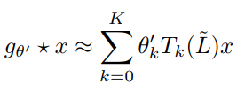
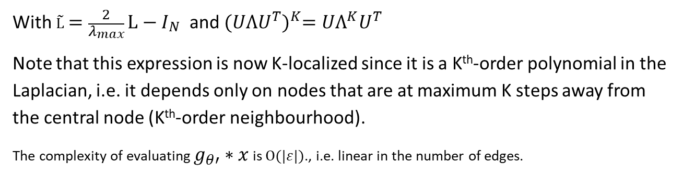
Defining the model- derive Spectral 1storder approx
Approximating using Chebyshev polynomials
With $\tilde{L}=\frac{2}{λ_{max}}L−I_{N}$ and ${(UΛU^{T})}^{K}=UΛ^{K}U^{T}$
Note that this expression is now K-localized since it is a K^{th}-order polynomial in the Laplacian, i.e. it depends only on nodes that are at maximum K steps away from the central node (K^{th}-order neighbourhood).
The complexity of evaluating $g_{θ′}∗x$ is $Ο(|ε|)$., i.e. linear in the number of edges.
Notes:
In this work, we encode the graph structure directly using a neural network model f(X,A) and train on a supervised target L0 for all nodes with labels, thereby avoiding explicit graph-based regularization in the loss function. Conditioning f(·) on the adjacency matrix of the graph will allow the model to distribute gradient information from the supervised lossL0 and will enable it to learn representations of nodes both with and without labels

Slide 9
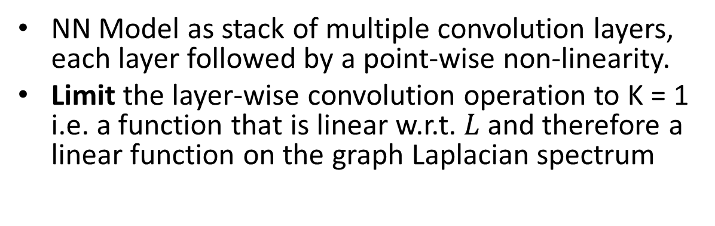
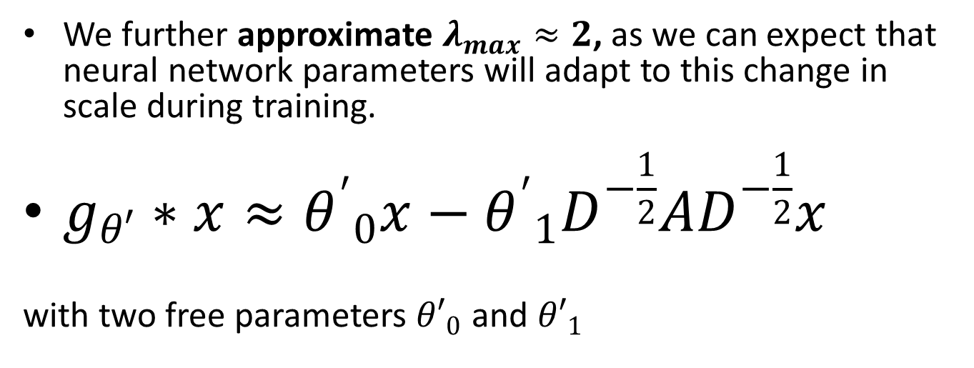
Defining the model- Layerwise Linear model
NN Model as stack of multiple convolution layers, each layer followed by a point-wise non-linearity.
Limit the layer-wise convolution operation to K = 1 i.e. a function that is linear w.r.t. $L$and therefore a linear function on the graph Laplacian spectrum
We further approximate $λ_{max}≈2$, as we can expect that neural network parameters will adapt to this change in scale during training.
$g_{θ′}∗x≈{θ^{′}}_{0}x−{θ^{′}}_{1}D^{−\frac{1}{2}}AD^{−\frac{1}{2}}x$
with two free parameters ${θ′}_{0}$ and ${θ′}_{1}$
Notes:
Limit the layer-wise convolution operation to K = 1 (see Eq. 5), i.e. a function that is linear w.r.t. $L$and therefore a linear function on the graph Laplacian spectrum

Slide 10
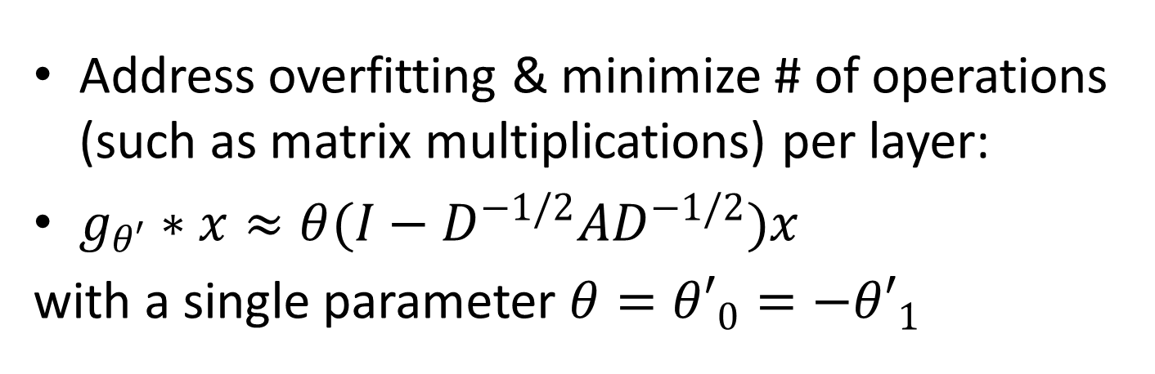
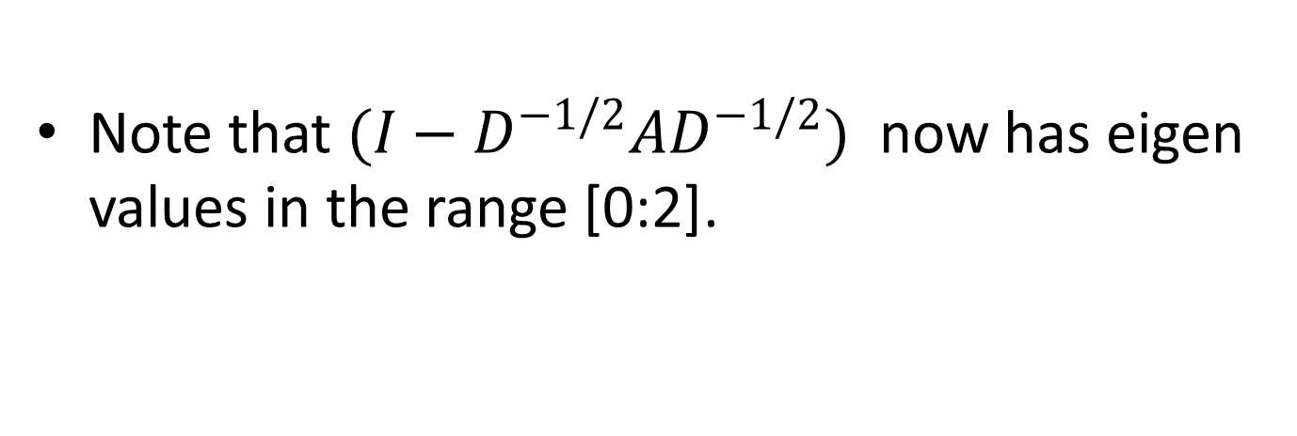
Defining the model- Layerwise Linear model – Contd..
Address overfitting & minimize # of operations (such as matrix multiplications) per layer:
$g_{θ′}∗x≈θ(I−D^{−1/2}AD^{−1/2})x$
with a single parameter $θ={θ′}_{0}=−{θ′}_{1}$
Note that $(I−D^{−1/2}AD^{−1/2})$ now has eigen values in the range [0:2].
Notes:
Limit the layer-wise convolution operation to K = 1 (see Eq. 5), i.e. a function that is linear w.r.t. $L$and therefore a linear function on the graph Laplacian spectrum

Slide 11
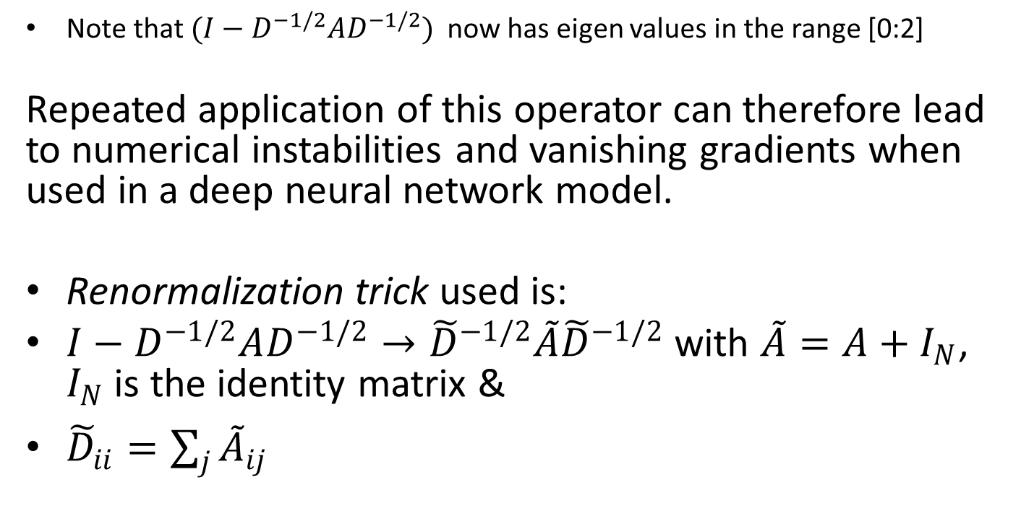
Defining the model- Layerwise Linear model – Contd..
Note that $(I−D^{−1/2}AD^{−1/2})$ now has eigen values in the range [0:2]
Repeated application of this operator can therefore lead to numerical instabilities and vanishing gradients when used in a deep neural network model.
Renormalization trick used is:
$I−D^{−1/2}AD^{−1/2}→{\tilde{D}}^{−1/2}\tilde{A}{\tilde{D}}^{−1/2}$ with $\tilde{A}=A+I_{N}$, $I_{N}$ is the identity matrix &
${\tilde{D}}_{ii}=\sum_{j}{{\tilde{A}}_{ij}}$
Notes:
Limit the layer-wise convolution operation to K = 1 (see Eq. 5), i.e. a function that is linear w.r.t. $L$and therefore a linear function on the graph Laplacian spectrum

Slide 12
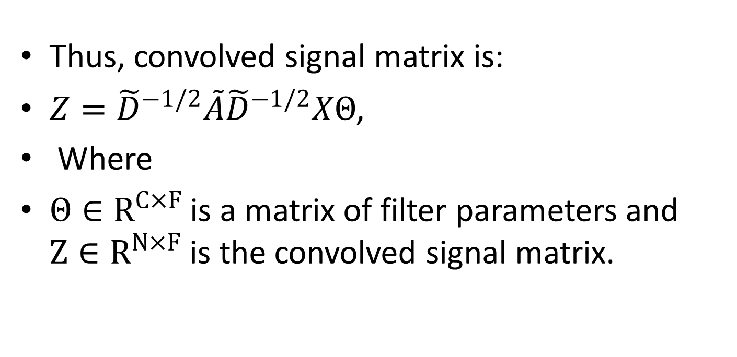
Defining the model- Layerwise Linear model – concludes...
Thus, convolved signal matrix is:
$Z={\tilde{D}}^{−1/2}\tilde{A}{\tilde{D}}^{−1/2}XΘ$,
Where
$Θ∈R^{C×F}$ is a matrix of filter parameters and $Z∈R^{N×F}$ is the convolved signal matrix.
Notes:
Limit the layer-wise convolution operation to K = 1 (see Eq. 5), i.e. a function that is linear w.r.t. $L$and therefore a linear function on the graph Laplacian spectrum

Slide 13
Graph Convolution network

Slide 14
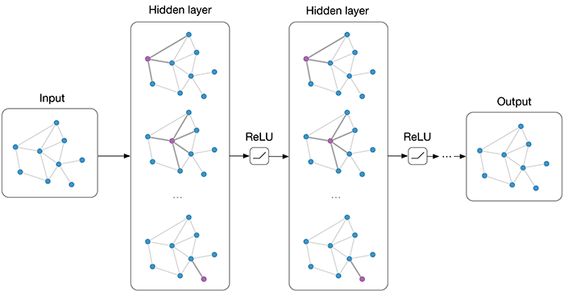
GCN
Notes:
The neural network weights W(0) and W(1) are trained using gradient descent. In this work, we perform batch gradient descent using the full dataset for every training iteration, which is a viable option as long as datasets ﬁt in memory. Using a sparse representation for A, memory requirement isO(|E|), i.e. linear in the number of edges. Stochasticity in the training process is introduced via dropout (Srivastava et al., 2014). We leave memory-efﬁcient extensions with mini-batch stochastic gradient descent for future work.

Slide 15
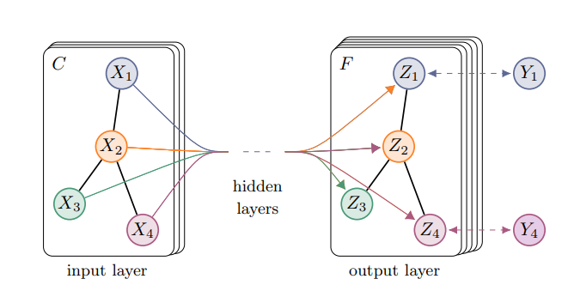
Example
Notes:
The neural network weights W(0) and W(1) are trained using gradient descent. In this work, we perform batch gradient descent using the full dataset for every training iteration, which is a viable option as long as datasets ﬁt in memory. Using a sparse representation for A, memory requirement isO(|E|), i.e. linear in the number of edges. Stochasticity in the training process is introduced via dropout (Srivastava et al., 2014). We leave memory-efﬁcient extensions with mini-batch stochastic gradient descent for future work.

Slide 16
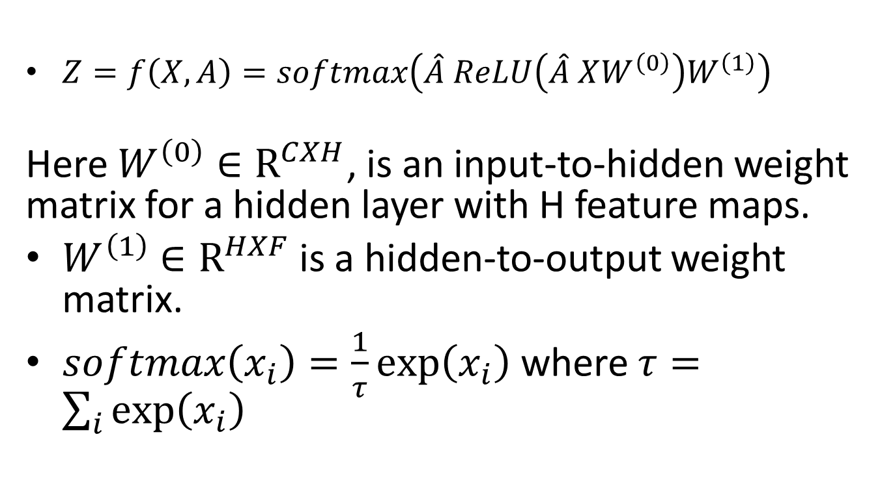
Forward pass function
$Z=f\left(X,A\right)=softmax\left(\hat{A} ReLU\left(\hat{A} XW^{\left(0\right)}\right)W^{\left(1\right)}\right)$
Here $W^{\left(0\right)}∈R^{CXH}$, is an input-to-hidden weight matrix for a hidden layer with H feature maps.
$W^{\left(1\right)}$ $∈R^{HXF}$is a hidden-to-output weight matrix.
$softmax\left(x_{i}\right)=\frac{1}{τ}exp⁡\left(x_{i}\right)$ where $τ=\sum_{i}{exp⁡\left(x_{i}\right) }$
Notes:
The neural network weights W(0) and W(1) are trained using gradient descent. In this work, we perform batch gradient descent using the full dataset for every training iteration, which is a viable option as long as datasets ﬁt in memory. Using a sparse representation for A, memory requirement isO(|E|), i.e. linear in the number of edges. Stochasticity in the training process is introduced via dropout (Srivastava et al., 2014). We leave memory-efﬁcient extensions with mini-batch stochastic gradient descent for future work.

Slide 17
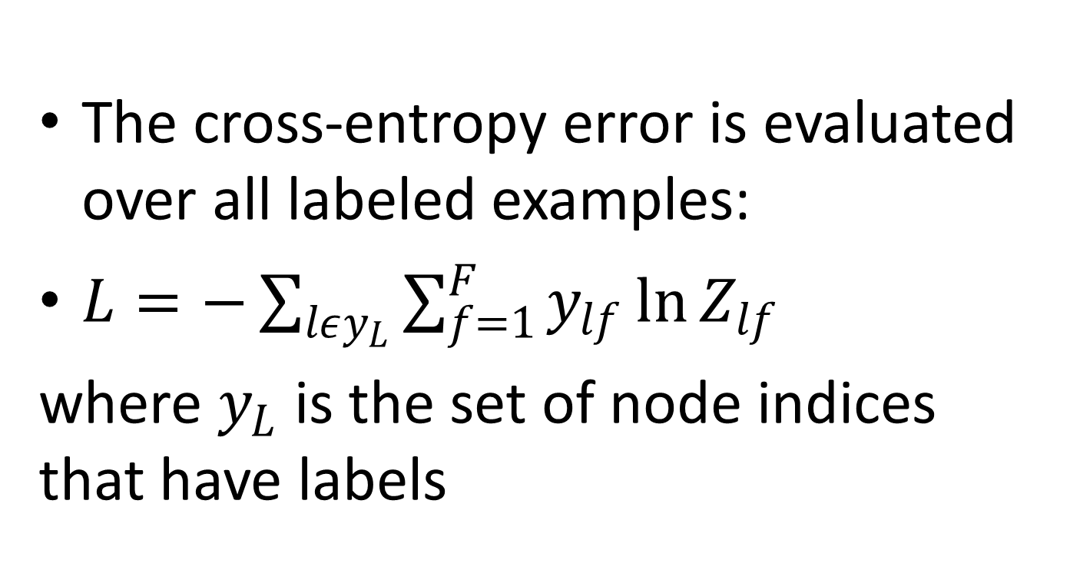
Loss function
The cross-entropy error is evaluated over all labeled examples:
$L=−\sum_{lεy_{L}}{\sum_{f=1}^{F}{y_{lf}\ln{Z_{lf}}}}$
where $y_{L}$ is the set of node indices that have labels

Slide 18
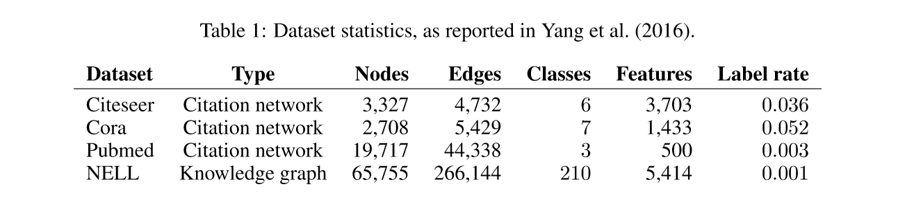
Experimentation- Dataset
The datasets contain sparse bag-of-words feature vectors for each document and a list of citation links between documents.
We treat the citation links as (undirected) edges and construct a binary, symmetric adjacency matrix A.
Each document has a class label. For training,we only use 20 labels per class, but all feature vectors.
Notes:
Citationnetworks We consider three citation network datasets: Citeseer, Cora and Pubmed (Sen et al., 2008). The datasets contain sparse bag-of-words feature vectors for each document and a list of citation links between documents. We treat the citation links as (undirected) edges and construct abinary,symmetricadjacencymatrix A. Eachdocumenthasaclasslabel. Fortraining,weonlyuse 20 labels per class, but all feature vectors.
NELL NELLisadatasetextractedfromtheknowledgegraphintroducedin(Carlsonetal.,2010). A knowledge graph is a set of entities connected with directed, labeled edges (relations). We follow the pre-processing scheme as described in Yang et al. (2016). We assign separate relation nodes r1 and r2 for each entity pair (e1,r,e2) as (e1,r1) and (e2,r2). Entity nodes are described by sparse feature vectors. We extend the number of features in NELL by assigning a unique one-hot representationforeveryrelationnode,effectivelyresultingina61,278-dimsparsefeaturevectorper node. The semi-supervised task here considers the extreme case of only a single labeled example per class in the training set. We construct a binary, symmetric adjacency matrix from this graph by setting entries Aij = 1, if one or more edges are present between nodes i and j.
Random graphs We simulate random graph datasets of various sizes for experiments where we measure training time per epoch. For a dataset with N nodes we create a random graph assigning 2N edges uniformly at random. We take the identity matrix IN as input feature matrix X, thereby implicitlytakingafeaturelessapproachwherethemodelisonlyinformedabouttheidentityofeach node, speciﬁed by a unique one-hot vector. We add dummy labels Yi = 1 for every node.
Unless otherwise noted, we train a two-layer GCN as described in Section 3.1 and evaluate prediction accuracy on a test set of 1,000 labeled examples. We provide additional experiments using deepermodelswithupto10layersinAppendixB.WechoosethesamedatasetsplitsasinYangetal. (2016) with an additional validation set of 500 labeled examples for hyperparameter optimization (dropout rate for all layers, L2 regularization factor for the ﬁrst GCN layer and number of hidden units). We do not use the validation set labels for training. For the citation network datasets, we optimize hyperparameters on Cora only and use the same set ofparametersforCiteseerandPubmed. Wetrainallmodelsforamaximumof200epochs(training iterations) using Adam (Kingma & Ba, 2015) with a learning rate of 0.01 and early stopping with a window size of 10, i.e. we stop training if the validation loss does not decrease for 10 consecutive epochs. We initialize weights using the initialization described in Glorot & Bengio (2010) and accordingly (row-)normalize input feature vectors. On the random graph datasets, we use a hidden layer size of 32 units and omit regularization (i.e. neither dropout nor L2 regularization).

Slide 19
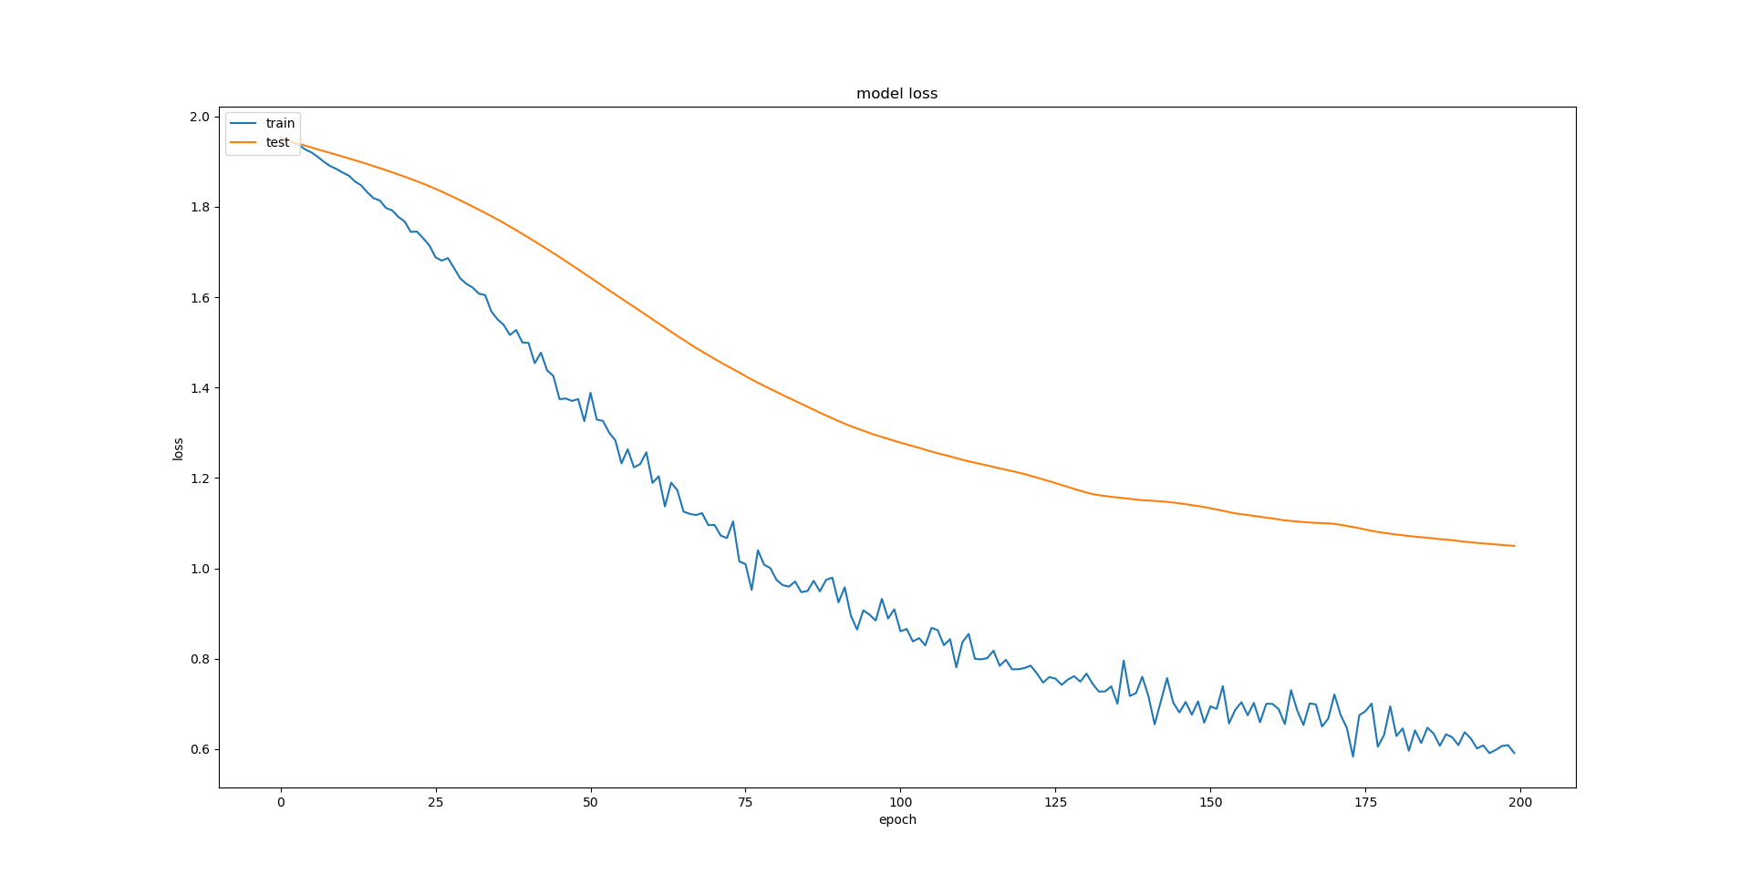
GCN- Loss- Learning Rate= 0.01
Notes:
The neural network weights W(0) and W(1) are trained using gradient descent. In this work, we perform batch gradient descent using the full dataset for every training iteration, which is a viable option as long as datasets ﬁt in memory. Using a sparse representation for A, memory requirement isO(|E|), i.e. linear in the number of edges. Stochasticity in the training process is introduced via dropout (Srivastava et al., 2014). We leave memory-efﬁcient extensions with mini-batch stochastic gradient descent for future work.

Slide 20
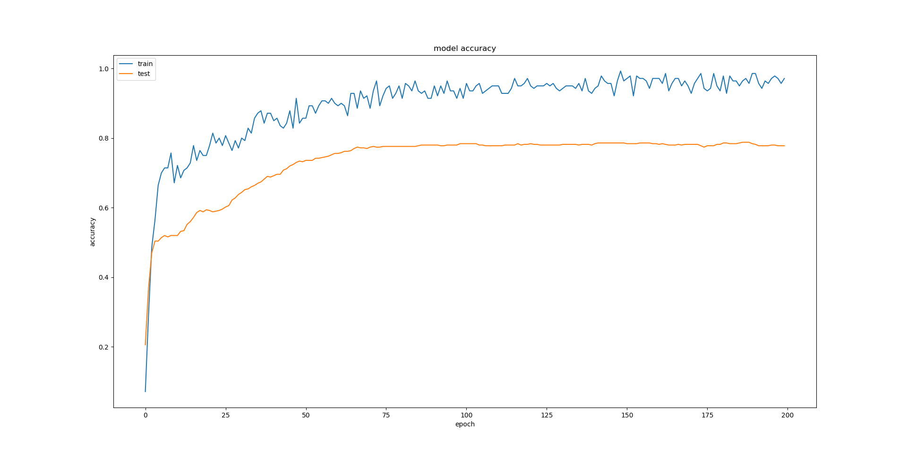
GCN- Accuracy- Learning Rate=0.01
Notes:
The neural network weights W(0) and W(1) are trained using gradient descent. In this work, we perform batch gradient descent using the full dataset for every training iteration, which is a viable option as long as datasets ﬁt in memory. Using a sparse representation for A, memory requirement isO(|E|), i.e. linear in the number of edges. Stochasticity in the training process is introduced via dropout (Srivastava et al., 2014). We leave memory-efﬁcient extensions with mini-batch stochastic gradient descent for future work.

Slide 21
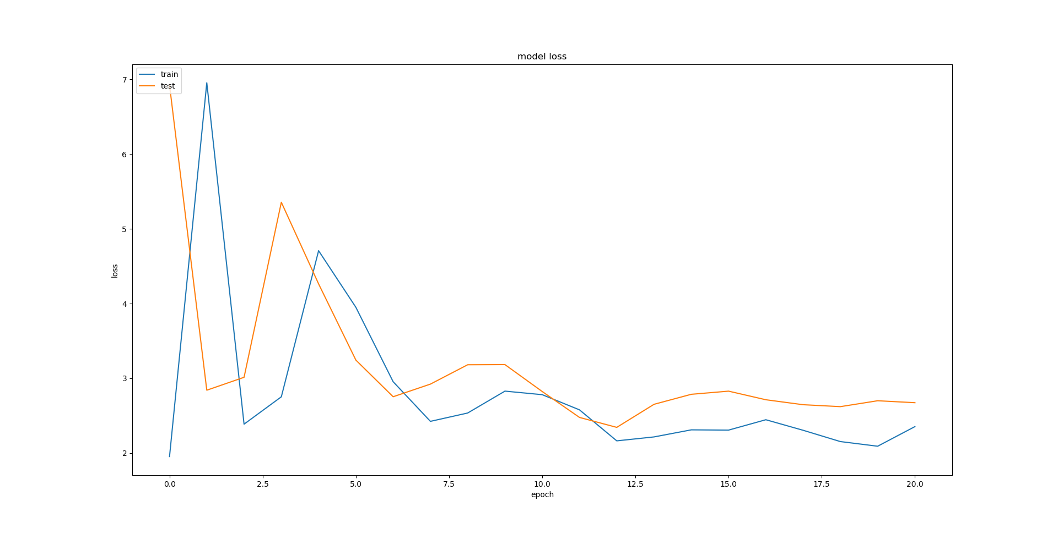
GCN- Loss- Learning Rate=1.0
Notes:
The neural network weights W(0) and W(1) are trained using gradient descent. In this work, we perform batch gradient descent using the full dataset for every training iteration, which is a viable option as long as datasets ﬁt in memory. Using a sparse representation for A, memory requirement isO(|E|), i.e. linear in the number of edges. Stochasticity in the training process is introduced via dropout (Srivastava et al., 2014). We leave memory-efﬁcient extensions with mini-batch stochastic gradient descent for future work.

Slide 22
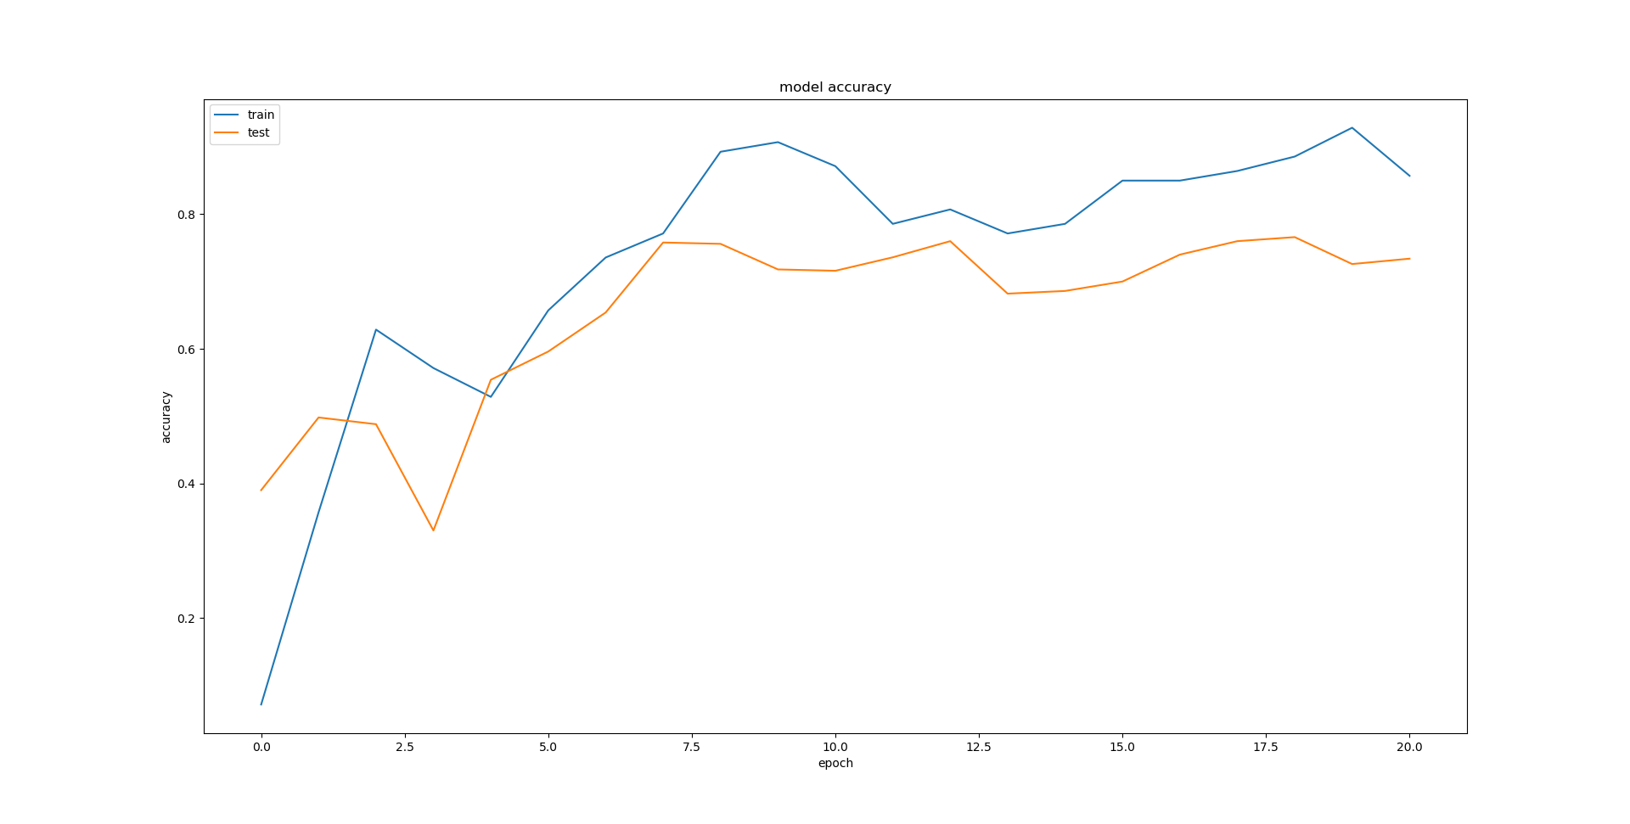
GCN- Accuracy- Learning Rate=1.0
Notes:
The neural network weights W(0) and W(1) are trained using gradient descent. In this work, we perform batch gradient descent using the full dataset for every training iteration, which is a viable option as long as datasets ﬁt in memory. Using a sparse representation for A, memory requirement isO(|E|), i.e. linear in the number of edges. Stochasticity in the training process is introduced via dropout (Srivastava et al., 2014). We leave memory-efﬁcient extensions with mini-batch stochastic gradient descent for future work.

Slide 23
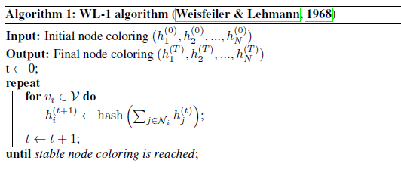
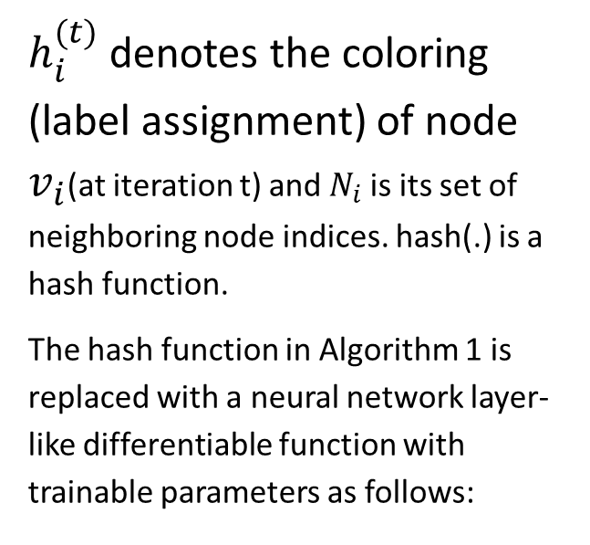
WL Algorithm
$h_{i}^{(t)}$ denotes the coloring (label assignment) of node $v_{i}$(at iteration t) and $N_{i}$ is its set of neighboring node indices. hash(.) is a hash function.
The hash function in Algorithm 1 is replaced with a neural network layer-like differentiable function with trainable parameters as follows:

Slide 24
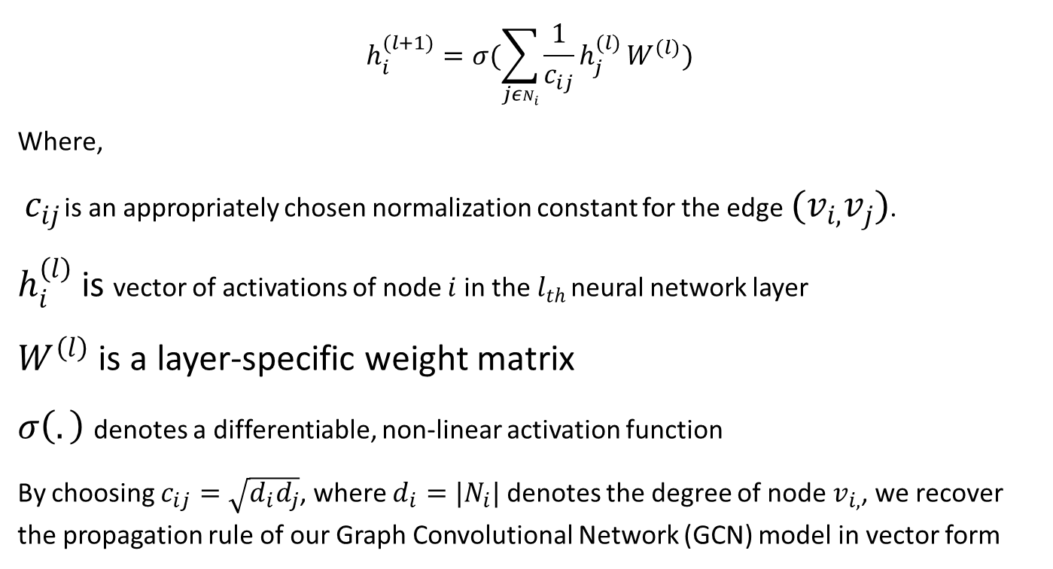
WL Algorithm
$$h_{i}^{(l+1)}=σ(\sum_{jεN_{i}}{\frac{1}{c_{ij}}h_{j}^{(l)}}W^{(l)})$$
Where,
$c_{ij}$ is an appropriately chosen normalization constant for the edge${(v}_{i,}v_{j})$.
$h_{i}^{\left(l\right)}$ is vector of activations of node $i$ in the $l_{th}$ neural network layer
$W^{\left(l\right)}$ is a layer-specific weight matrix
$σ\left(.\right)$ denotes a differentiable, non-linear activation function
By choosing $c_{ij}=\sqrt{d_{i}d_{j}}$, where $d_{i}=|N_{i}|$ denotes the degree of node $v_{i,}$, we recover the propagation rule of our Graph Convolutional Network (GCN) model in vector form

Slide 25
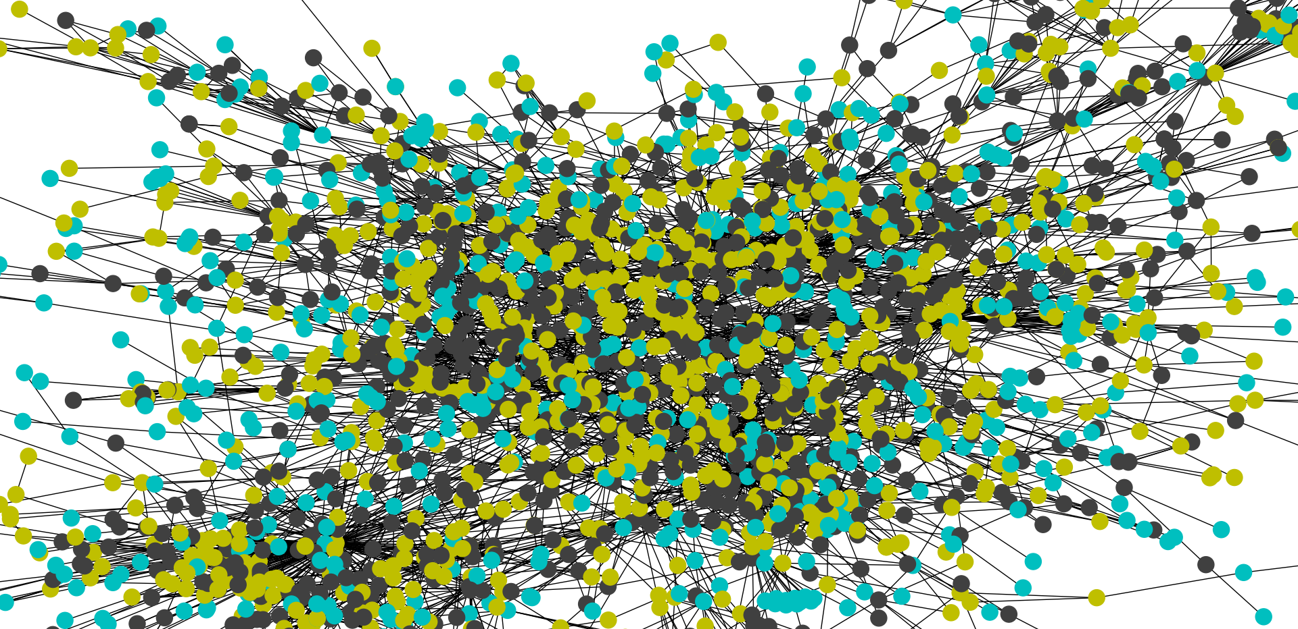
WL- Actual
Notes:
The neural network weights W(0) and W(1) are trained using gradient descent. In this work, we perform batch gradient descent using the full dataset for every training iteration, which is a viable option as long as datasets ﬁt in memory. Using a sparse representation for A, memory requirement isO(|E|), i.e. linear in the number of edges. Stochasticity in the training process is introduced via dropout (Srivastava et al., 2014). We leave memory-efﬁcient extensions with mini-batch stochastic gradient descent for future work.

Slide 26
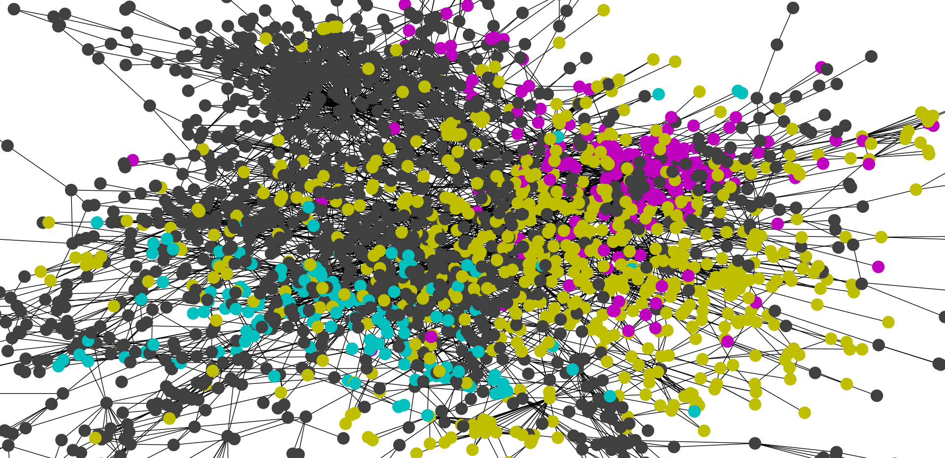
WL- Expected
Notes:
The neural network weights W(0) and W(1) are trained using gradient descent. In this work, we perform batch gradient descent using the full dataset for every training iteration, which is a viable option as long as datasets ﬁt in memory. Using a sparse representation for A, memory requirement isO(|E|), i.e. linear in the number of edges. Stochasticity in the training process is introduced via dropout (Srivastava et al., 2014). We leave memory-efﬁcient extensions with mini-batch stochastic gradient descent for future work.

Slide 27
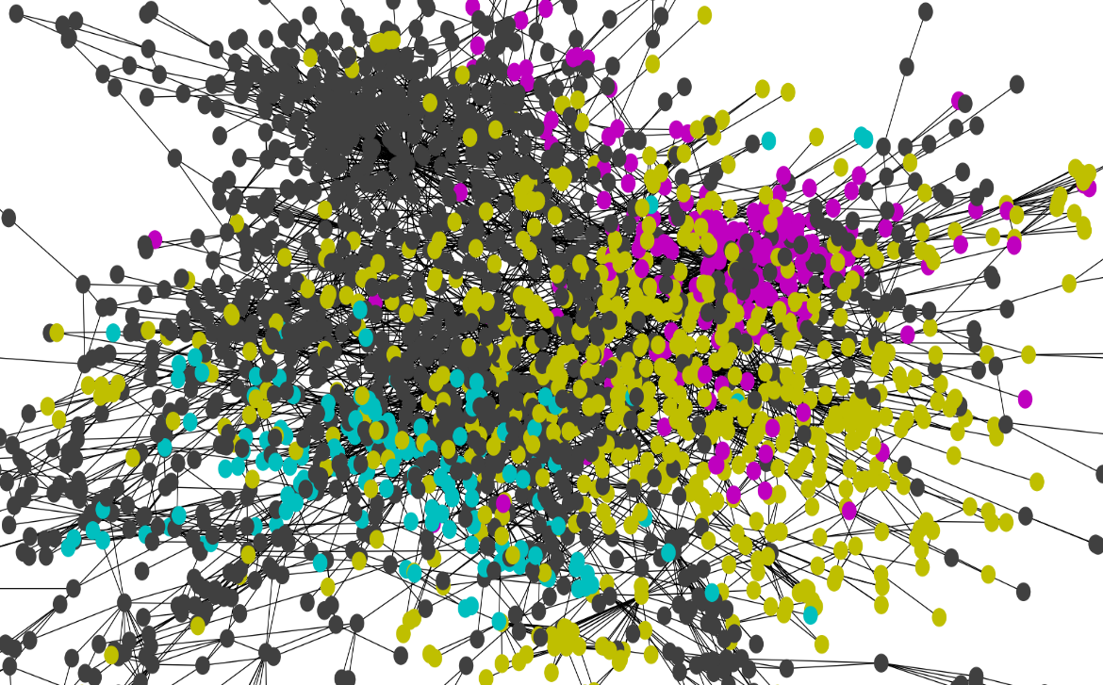

WL- Expected V/s Actual
Notes:
The neural network weights W(0) and W(1) are trained using gradient descent. In this work, we perform batch gradient descent using the full dataset for every training iteration, which is a viable option as long as datasets ﬁt in memory. Using a sparse representation for A, memory requirement isO(|E|), i.e. linear in the number of edges. Stochasticity in the training process is introduced via dropout (Srivastava et al., 2014). We leave memory-efﬁcient extensions with mini-batch stochastic gradient descent for future work.

Slide 28
Discussion
Graph Regularization Method
Limitation as assumes that edges encode mere similarity of the nodes
Skip Gram based
Based on multi-step pipeline and therefore difficult to optimize
GCN model
Propagation of feature information from neighboring nodes in every layer improves classification performance

Slide 29
Limitations & Future Work
Memory Requirements
Directed Edges and edge features
Limiting assumptions
Notes:
Memoryrequirement In the current setup with full-batch gradient descent, memory requirement grows linearly in the size of the dataset. We have shown that for large graphs that do not ﬁt in GPU memory, training on CPU can still be a viable option. Mini-batch stochastic gradient descent can alleviatethisissue. Theprocedureofgeneratingmini-batches,however,shouldtakeintoaccountthe numberoflayersintheGCNmodel,asthe Kth-orderneighborhoodforaGCNwith K layershasto be stored in memory for an exact procedure. For very large and densely connected graph datasets, further approximations might be necessary.
Directed edges and edge features Our framework currently does not naturally support edge features and is limited to undirected graphs (weighted or unweighted). Results on NELL however show that it is possible to handle both directed edges and edge features by representing the original directed graph as an undirected bipartite graph with additional nodes that represent edges in the original graph (see Section 5.1 for details).
Limitingassumptions ThroughtheapproximationsintroducedinSection2,weimplicitlyassume locality (dependence on the Kth-order neighborhood for a GCN with K layers) and equal importance of self-connections vs. edges to neighboring nodes. For some datasets, however, it might be beneﬁcial to introduce a trade-off parameter λ in the deﬁnition of ˜ A: ˜ A = A + λIN . (11) 4Hardware used: 16-core Intel R
Xeon R
CPU E5-2640 v3 @ 2.60GHz, GeForce R
GTX TITAN X
8
Published as a conference paper at ICLR 2017
Thisparameternowplaysasimilarroleasthetrade-offparameterbetweensupervisedandunsupervised loss in the typical semi-supervised setting (see Eq. 1). Here, however, it can be learned via gradient descent.

Slide 30
Limitations & Future Work
Appendix
Notes:
Memoryrequirement In the current setup with full-batch gradient descent, memory requirement grows linearly in the size of the dataset. We have shown that for large graphs that do not ﬁt in GPU memory, training on CPU can still be a viable option. Mini-batch stochastic gradient descent can alleviatethisissue. Theprocedureofgeneratingmini-batches,however,shouldtakeintoaccountthe numberoflayersintheGCNmodel,asthe Kth-orderneighborhoodforaGCNwith K layershasto be stored in memory for an exact procedure. For very large and densely connected graph datasets, further approximations might be necessary.
Directed edges and edge features Our framework currently does not naturally support edge features and is limited to undirected graphs (weighted or unweighted). Results on NELL however show that it is possible to handle both directed edges and edge features by representing the original directed graph as an undirected bipartite graph with additional nodes that represent edges in the original graph (see Section 5.1 for details).
Limitingassumptions ThroughtheapproximationsintroducedinSection2,weimplicitlyassume locality (dependence on the Kth-order neighborhood for a GCN with K layers) and equal importance of self-connections vs. edges to neighboring nodes. For some datasets, however, it might be beneﬁcial to introduce a trade-off parameter λ in the deﬁnition of ˜ A: ˜ A = A + λIN . (11) 4Hardware used: 16-core Intel R
Xeon R
CPU E5-2640 v3 @ 2.60GHz, GeForce R
GTX TITAN X
8
Published as a conference paper at ICLR 2017
Thisparameternowplaysasimilarroleasthetrade-offparameterbetweensupervisedandunsupervised loss in the typical semi-supervised setting (see Eq. 1). Here, however, it can be learned via gradient descent.

Slide 31
Clustering & Laplacian
Spectral Clustering Approach
Graph Laplacian Intuition

Slide 32
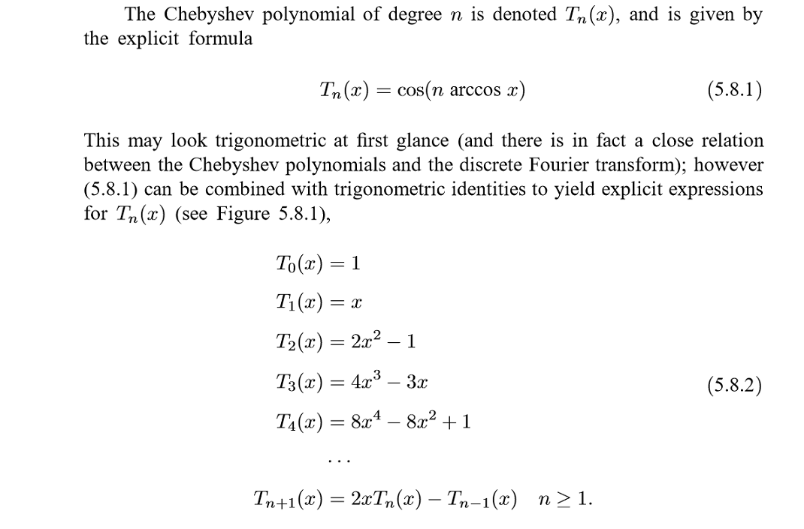
Chebyshev Approximation

Slide 33
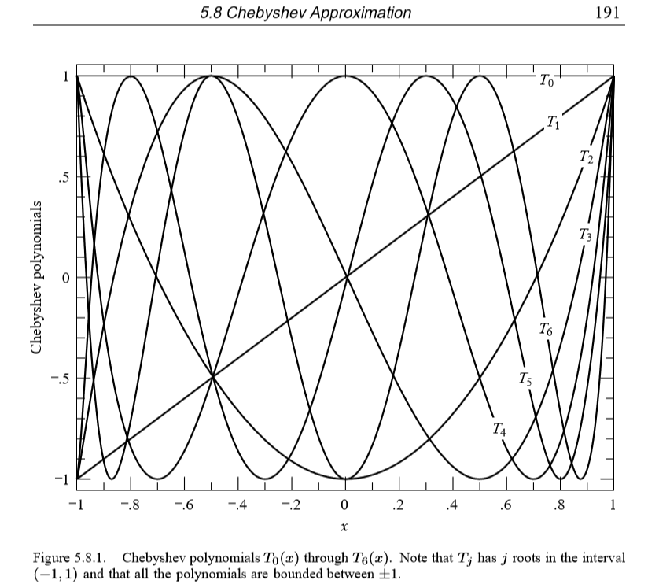
Chebyshev Approximation

Slide 34
Clustering
Partition in such a way that there is a strong connection between the members of the same cluster and weak connection between cluster members.
How do we efficiently find a good partition?
Problem: Computing optimal cut is NP-hard

Slide 35
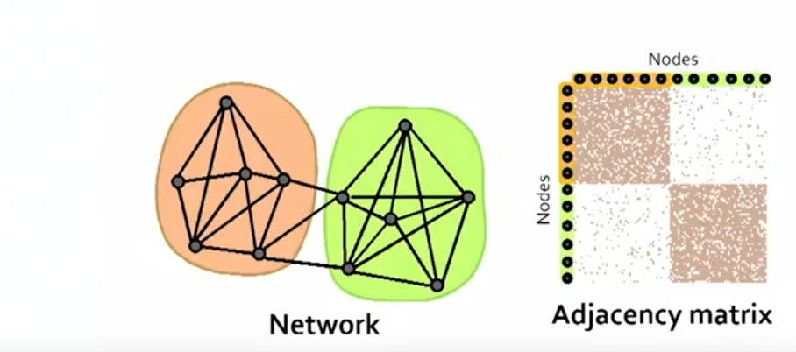
Spectral Clustering Algorithms

Slide 36

Spectral Clustering Algorithms

Slide 37
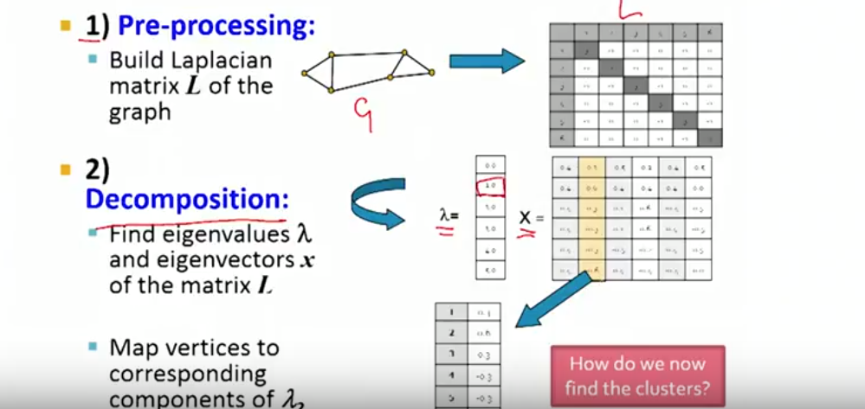
Spectral Clustering Algorithms

Slide 38
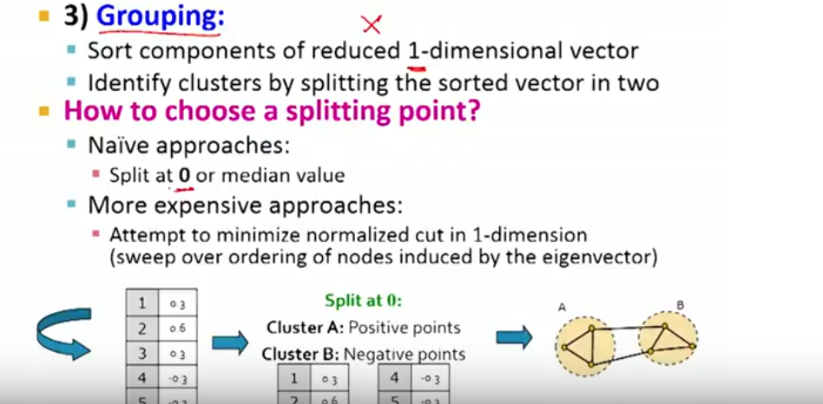
Example- Spectral Clustering

Slide 39
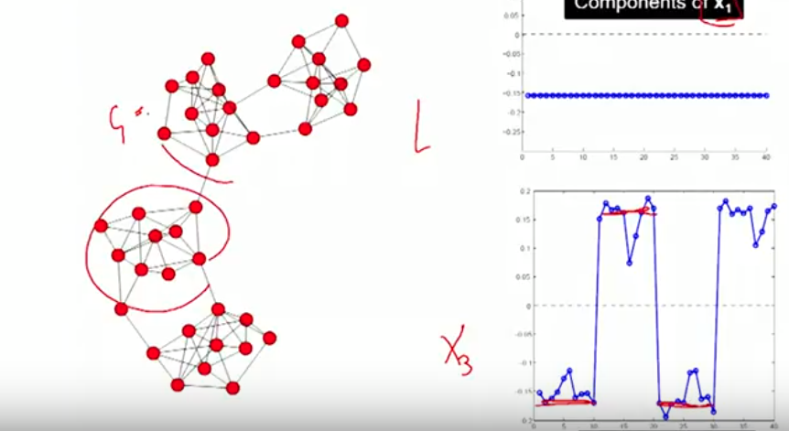
K-Way Spectral Clustering

Slide 40
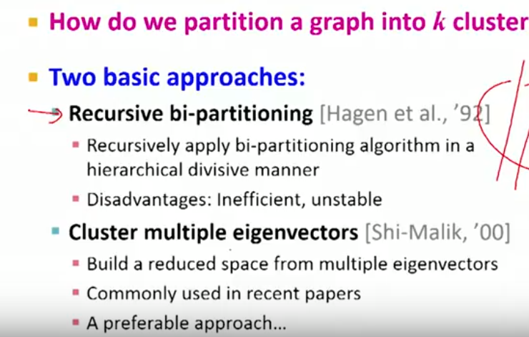
Finding Clusters
Every node is asking - What are the labels of my neighbors?
Let me sum up these neighbors and now think of this as new value of me.

Slide 41
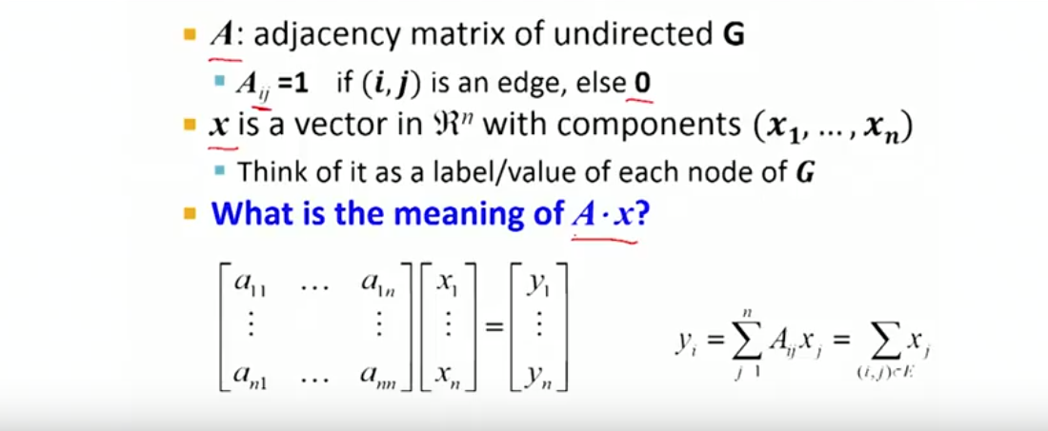
Examples of Eigendecompositions of Graphs
D-regular graph.. In continuation, lets check out the 2 Graph

Slide 42
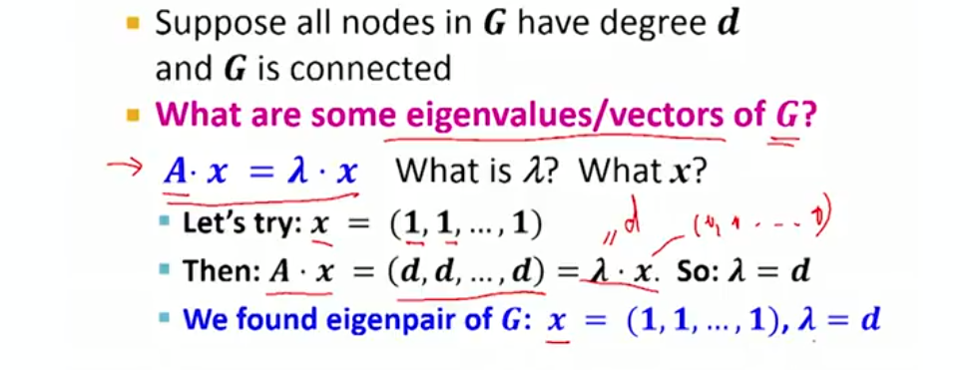
Examples of Eigendecompositions of Graphs- 2 components
D-regular graph.. In continuation, lets check out the 2 Graph

Slide 43
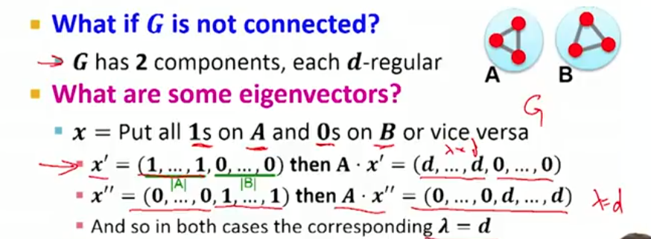
Meaning of A.x?
Every node is asking - What are the labels of my neighbors?
Let me sum up these neighbors and now think of this as new value of me.

Slide 44
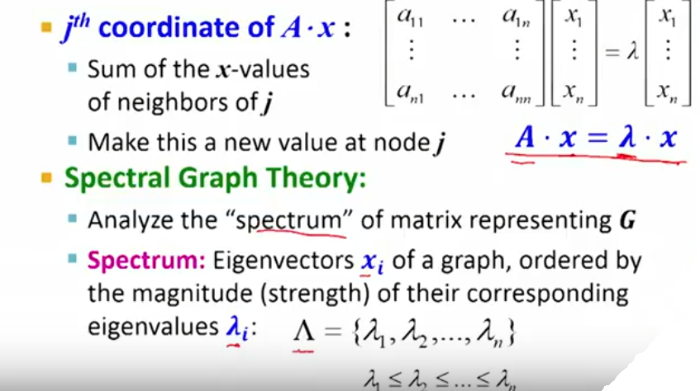
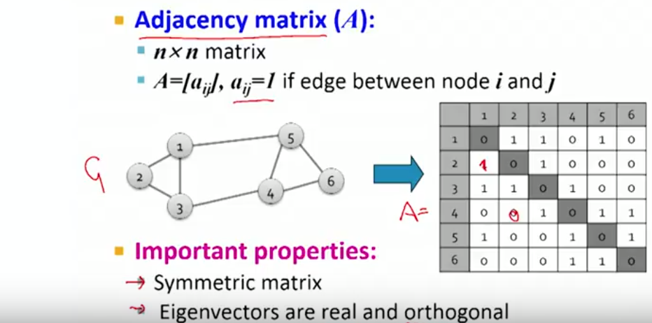
Matrix representation

Slide 45
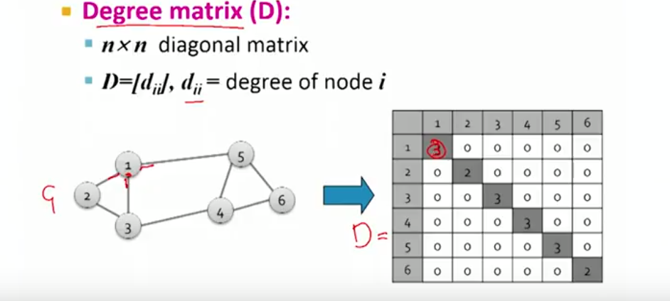
Laplacian Matrix
Eignen Values are orthonormal
- Sum of entries in Each row and Each column are zero

Slide 46
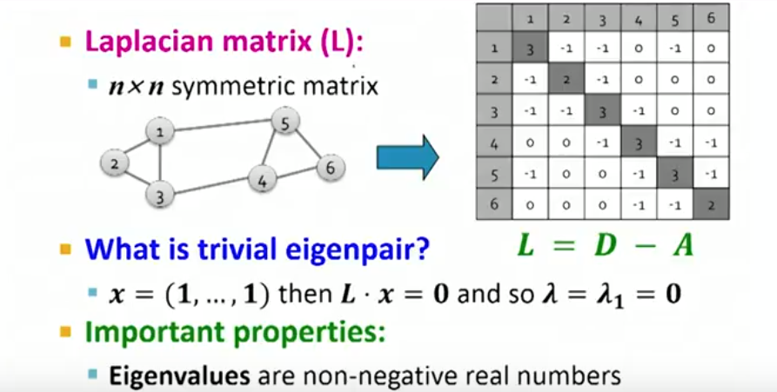
Find a good Partition
What is the meaning of the Eigen vectors & Eigen values of this Laplacian matrix?
Taking second eigen vector as the optimization problem- Minimizing the cut of
partition by finding a non-trivial vector x( lambda 2)

Slide 47
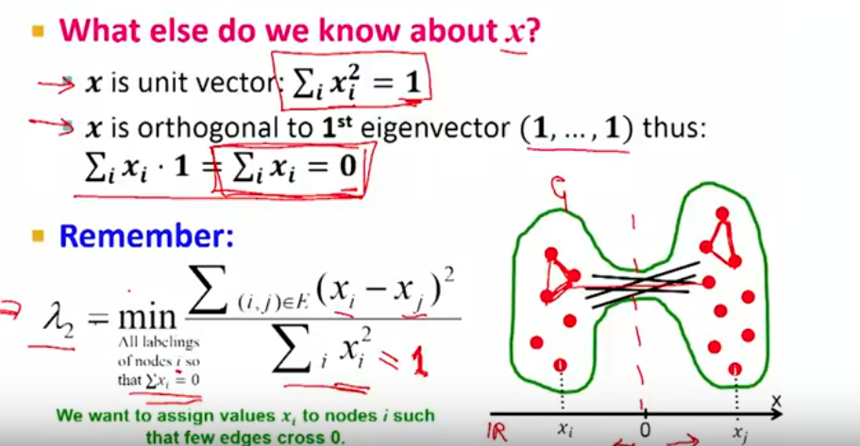
Find optimal Cut[Fiedler]

Slide 48
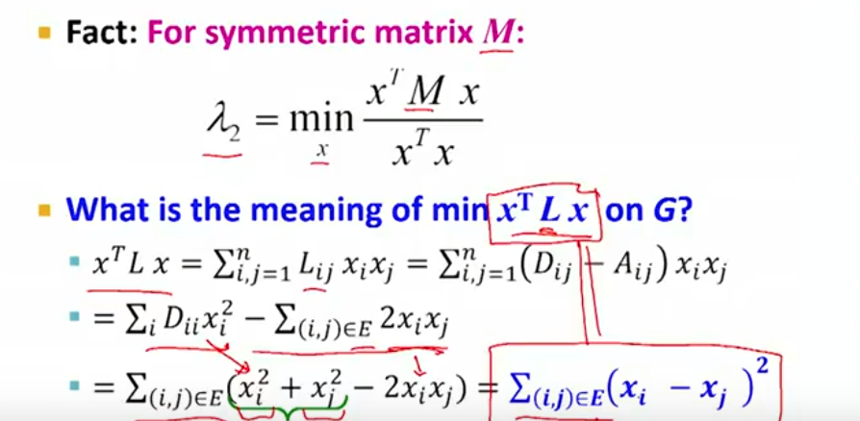
Rayleigh Theorem[Relaxation on x]
Laplacian allows or enables you to define the Xs such that it balances to minimize

